Slide 1

UNB Data Challenge – Visualization Track Housing Availability in Atlantic Canada
Presented by –
Team Dummy Variables

Slide 2

“NO PLACE TO CALL HOME”

Slide 3


Agenda
Population Growth Slide 3 - 5
Sore in Housing market Slide 6 - 7
Affordability & Availability crisis Slide 8 - 9
Rise of Homelessness Slide 10
Call to Action Slide 11

Slide 4




Mr. David is searching for a place to call home in Canada
Mr. David & family immigrated to Canada in 2018. Let’s analyze their journey
Below are his criteria for decision making
Plan for faster settlement
Have better opportunities
Stay within their budget

Slide 5
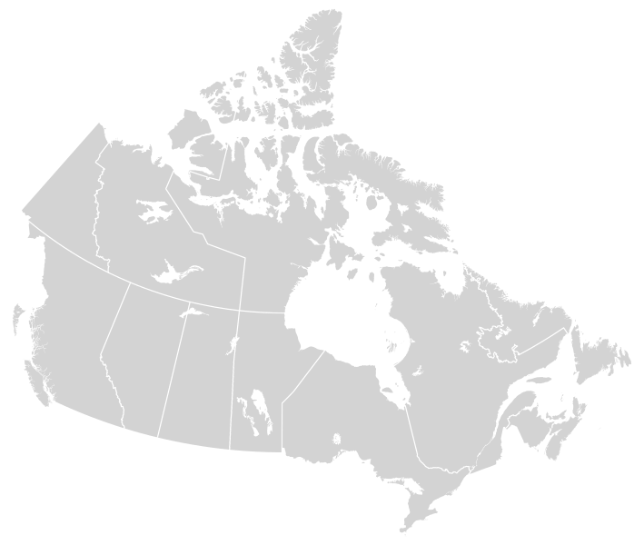



Cities like Halifax in Atlantic Canada had lowest average cost in 2018
Mr. David is happy and decides to move to Halifax as
Housing purchase price
Housing rental price
50% less expensive
Opportunities on the rise
Montreal
$350K
$1450
Vancouver
$1.5M
$2100
Halifax
$260K
$925
Toronto
$1M
$2200

Slide 6

Covid acted as a catalyst triggering 100K+ people to move to ‘Atlantic Canada’
2023 56k
Mr. David is now little worried !!
1 in 10
New settlers preferred to live in Maritime Cities of which 60% were from Ontario
2022
42k
2021
41k
2019
23K
2020
16K
Sources: Government of Canada. Statistics Canada. Table 17-10-0008-01 Estimates of the components of demographic growth, annual https://www150.statcan.gc.ca/t1/tbl1/en/tv.action?pid=1710000801; Government of Canada

Slide 7




Vacancy Rate has reduced significantly post covid due to increased migration
Mr. David is glad to see new people in his community ?
Vacancy rate is shown per 100 houses
3.7
3.4
55%
3.3
1.8
1.5
2018
2019
2020
2021
2022
Source: https://www150.statcan.gc.ca/t1/tbl1/en/tv.action?pid=3410012701

Slide 8

Soaring housing prices – Does $1300 rent for 1 bedroom make sense?
Mr. David is now worried by the increasing prices as
33%
increase in Average Rent & Housing Price
BEFORE COVID
2018
AFTER COVID
2022
$975
Avg Rental Prices
$1295
$260 K
Avg Housing Prices
$345 K
Source: https://rentals.ca/blog/rentals-ca-november-2022-rent-report

Slide 9








FACTORS CONTRIBUTING TOWARDS LOW AVAILABILITY & AFFORDABILITY
Core Housing Needs
Affordability =
Spend <30% on shelter
Adequacy =
Less Housing in Repair
Suitability =
Enough Space for all
1 in 10
1 in 7
Increasing Core
Housing Needs
3%
1 in 6
Low construction rate
1 in 7
16%
Source: Statistics Canada. Housing Starts + UnderConstruction + Completion 2018-2022; Government of Canada

Slide 10





FACTORS CONTRIBUTING TOWARDS LOW AVAILABILITY & AFFORDABILITY
122
Housing Price Index
22%
114
120
103
100
100
5380
5410
5350
Total Household Income
1%
5340
5220
5310
2023
Inflation Rates
2.8%
2018
2019
2020
2021
2022
Housing Price Index
Total Household Income
Mortgage Rates
1.3%

Slide 11

The Atlantic Canada Homelessness rate has escalated causing more concerns
Mr. David is now worried by the increasing prices as
2018
2022
N.B
560
N.F.L
900
6.5%
7.2%
P.E.I
160
>2263
are currently homeless in Atlantic provinces and the number is just expected to Double by End of the year
N.S
643
Source: https://www150.statcan.gc.ca/n1/pub/75f0002m/75f0002m2023004-eng.htm

Slide 12




The following recommendations will cater to core housing needs
Mr. David is still hopeful about the future
Accelerating building project approvals (cutting away excess lead times etc.,)
Government capping rents and mortgage rates, boosting investments
Creating non-profit homes (subsidized rates, modular homes etc.,)
Protect and upgrade existing houses

Slide 13

Team – Dummy Variables

